Slide 1

P.I.E. - Pixel Image Editor
Sprint Two Overview

Slide 2
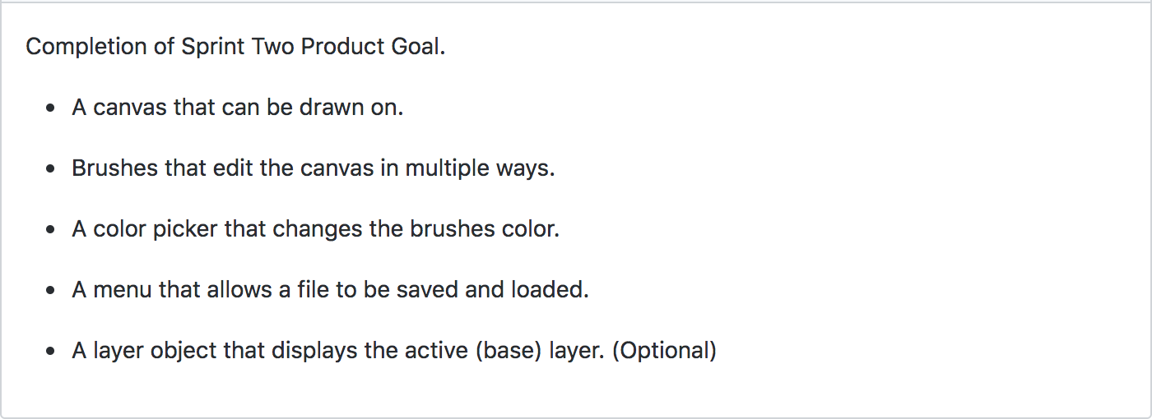
The Plan
Original Sp2 tasks from GitHub

Slide 3
Issues with “The Plan”
We wanted to complete the full functionality in sprint 2?

Slide 4
The Revised Plan
Finish Skeleton of App
Create ‘Layer Panel’ (Optional)
Add ‘Floating Window’ Class
Add Floating windows and dock sites for all panels
Redesign Canvas class to function properly

Slide 5
What We Accomplished
Finished Skeleton of App
Created ‘Layer Panel’
Added ‘Floating Window’ Class
Added Floating windows and dock sites for all panels
Redesigned Canvas class to function properly (half implemented)
Extras
Added pie icon splash screen
Added a pie icon in taskbar (Windows & Linux only)
Created a color matrix (Not implemented)
Created a ‘getColor’ class to be used for custom color picking (Not implemented)

Slide 6
What We Didn’t Accomplish
We Met Our Sprint Goal!
The revised one anyway...

Slide 7
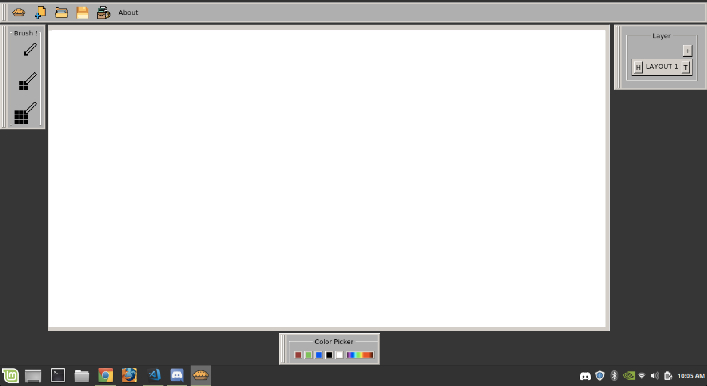
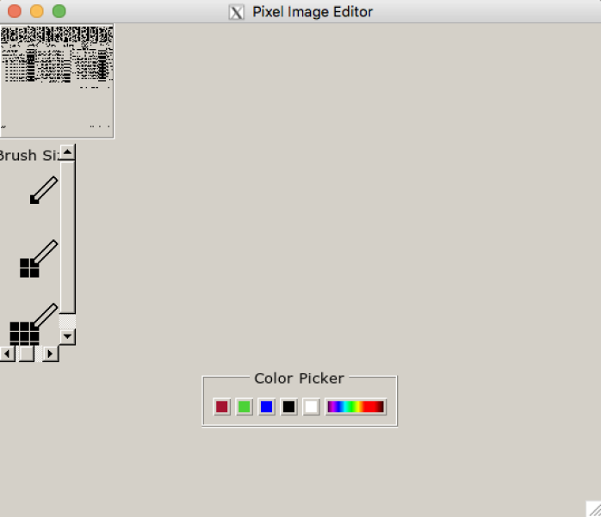
Sprint 1 V.S. Sprint 2
P.I.E-Sp1
P.I.E-Sp2

Slide 8
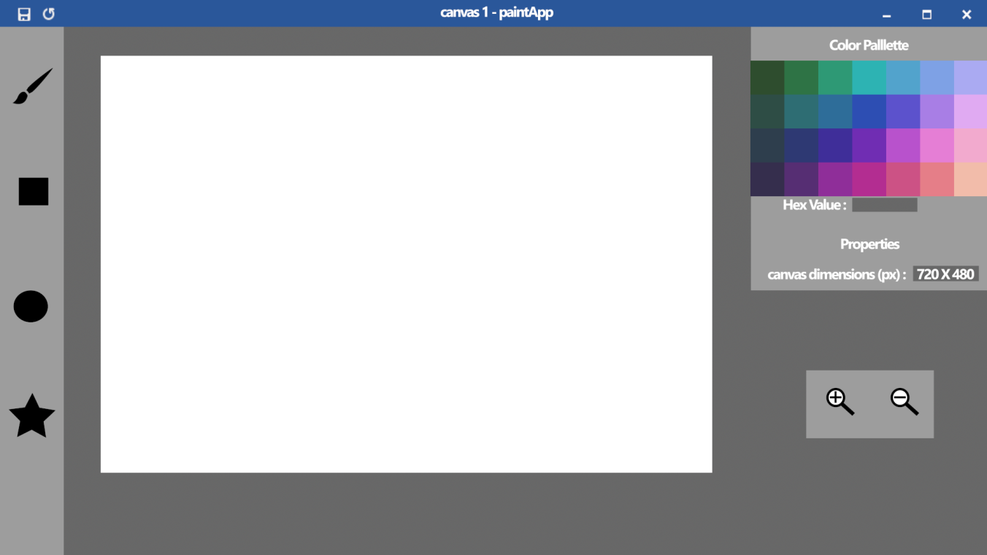
Concept V.S. Actual
P.I.E-Concept
P.I.E-Sp2

Slide 9
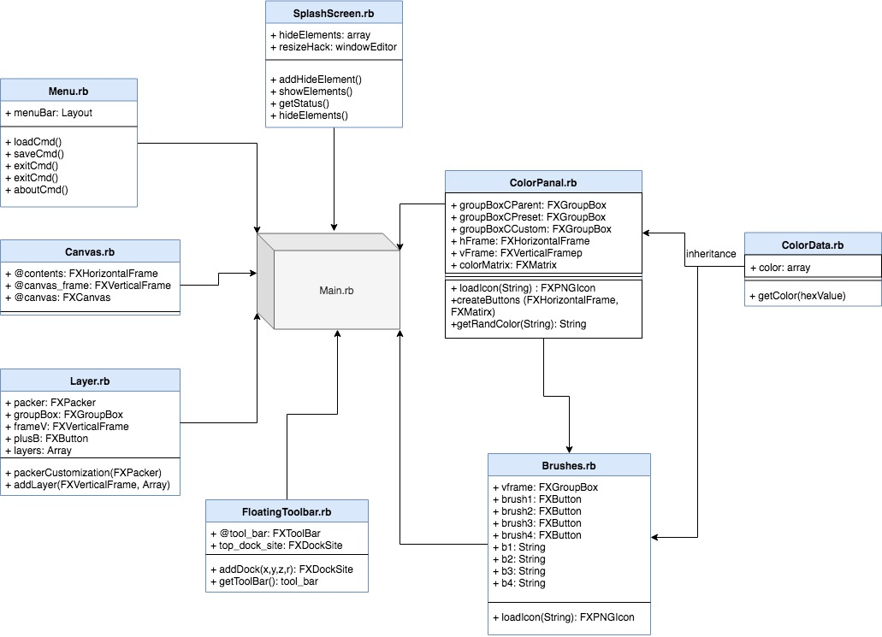
Current Program Structure

Slide 10
Looking Ahead
A full skeleton means easier, more streamlined development of functionality. Having this skeleton will improve our productivity for future sprints.
Now that we have a full skeleton…
Begin to slowly add functionality
Add simple actions to buttons, drawable canvas, add methods to handle custom colors or brush sizes etc.

